Slide 1
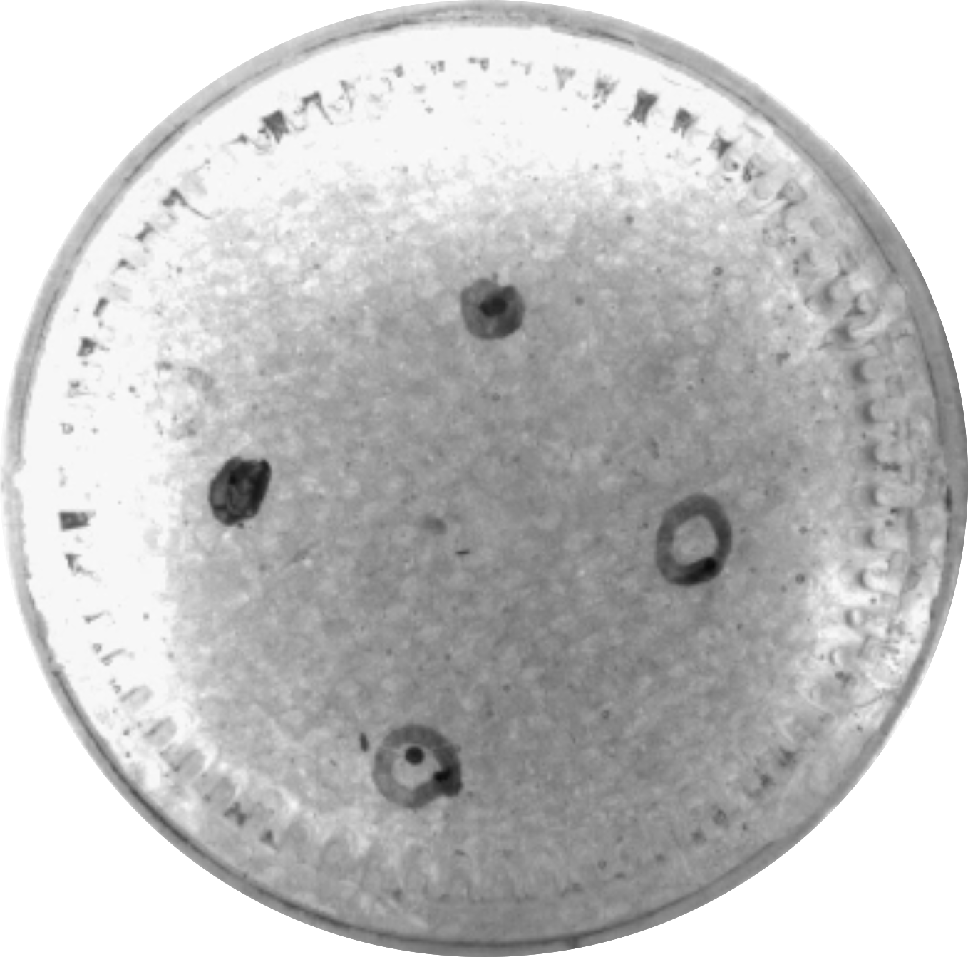
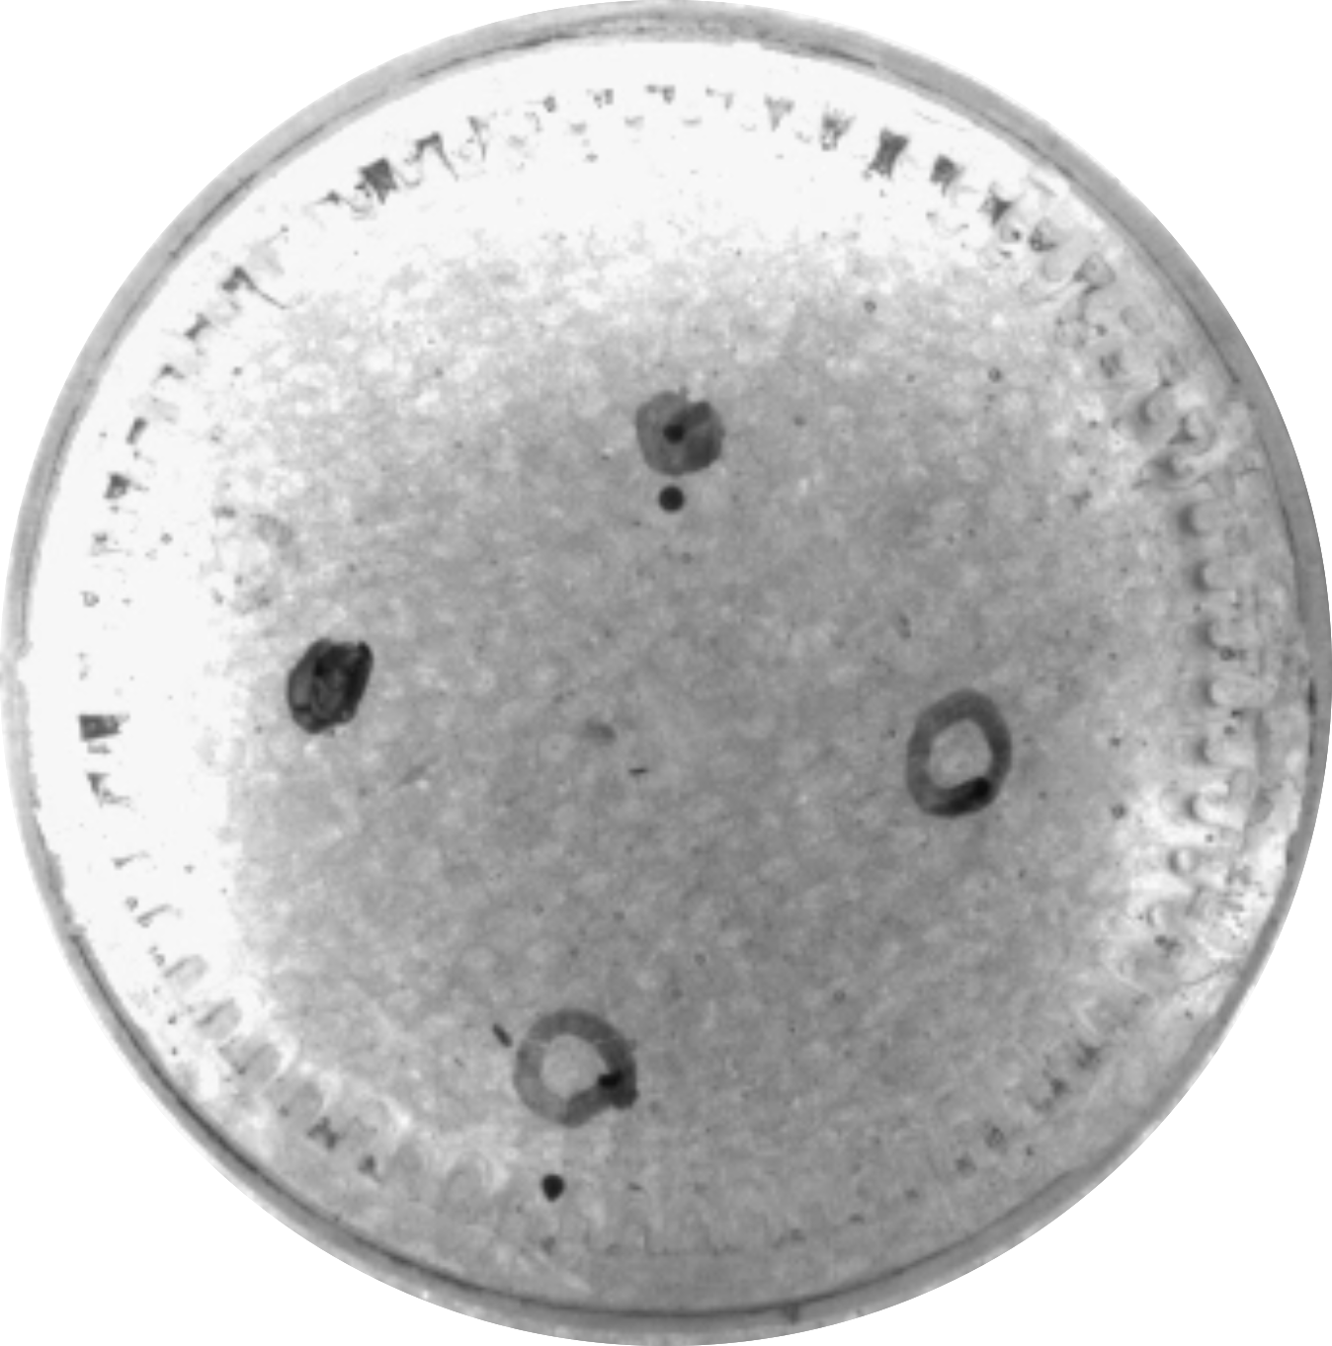
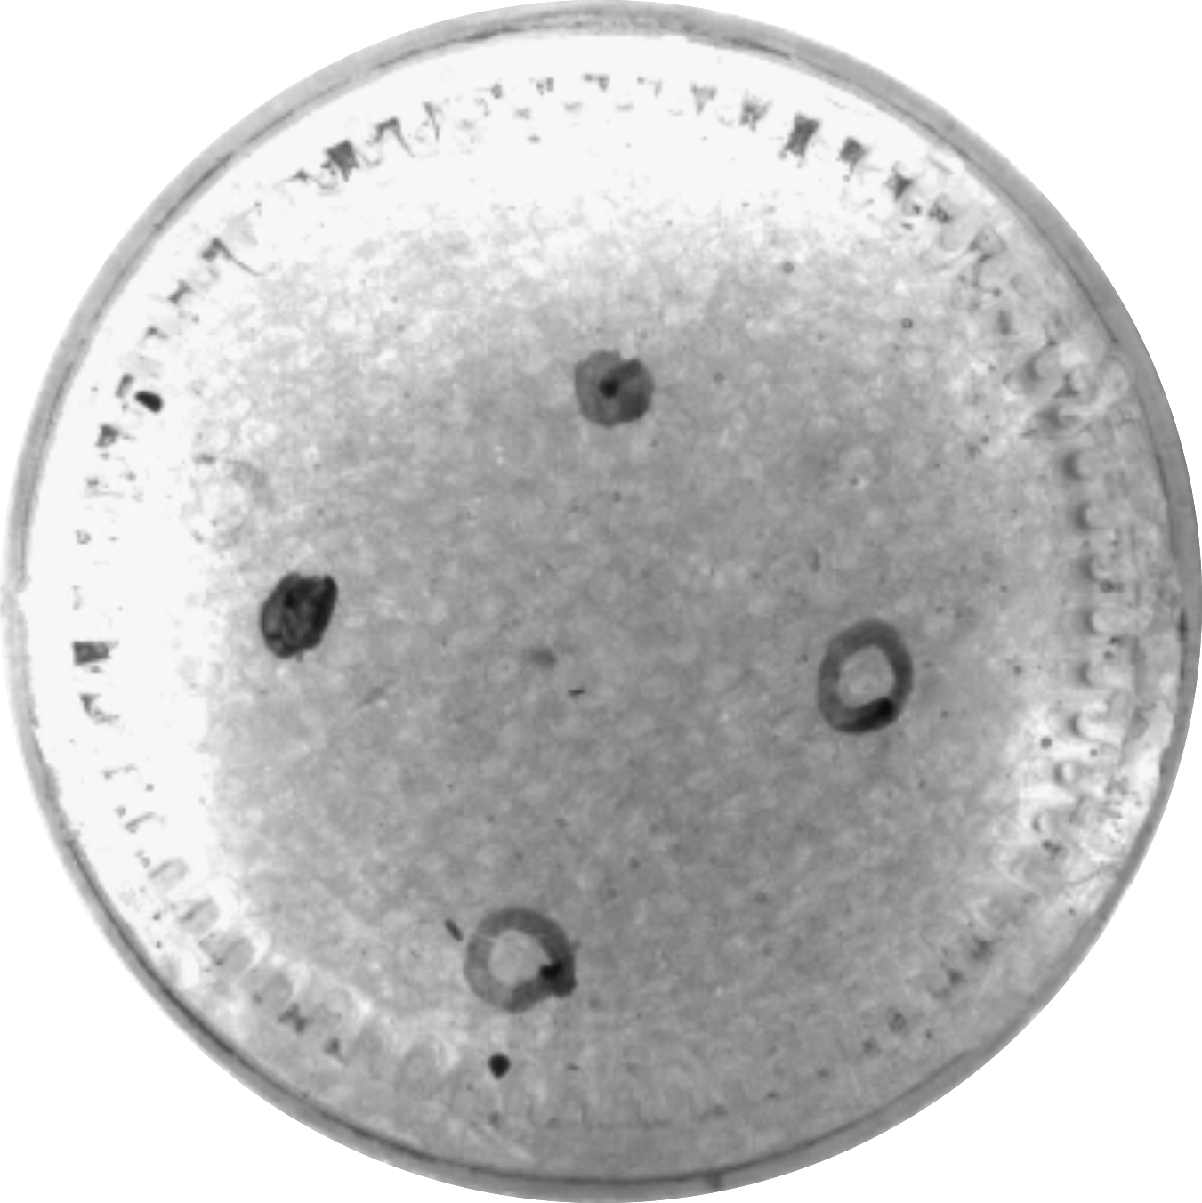


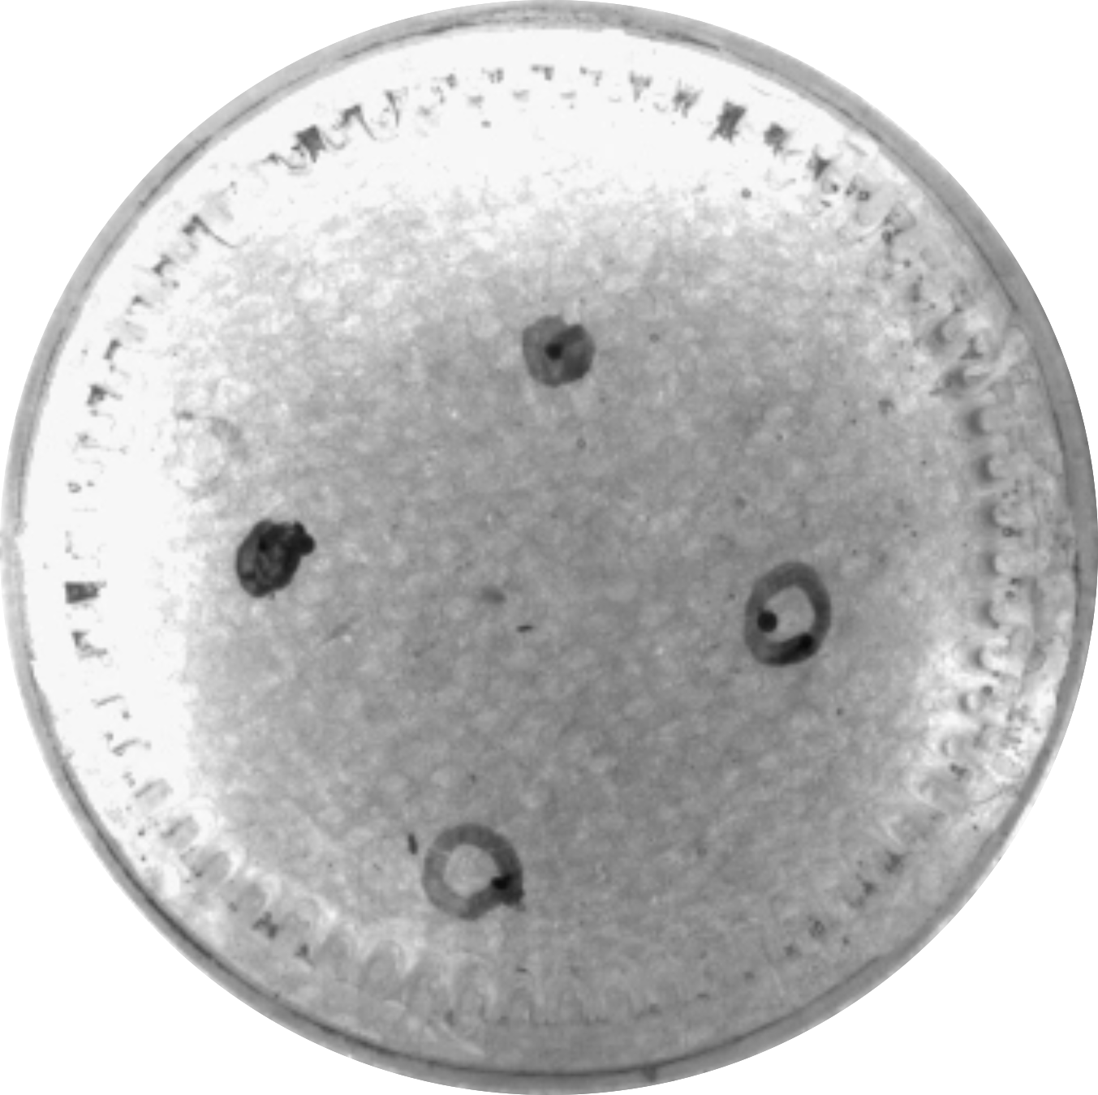
5 mm
5 mm
5 mm
5 mm
5 mm
5 mm
P₁ Start
0.5 mm magnets
P₂ Goal
P₁ Goal
P₂ Start

